Slide 1
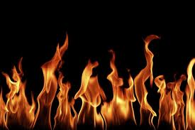
BURN INJURIES

Slide 2
BURN STATS
The 2012 National Burn Repository reviewed the combined data set of acute burn admissions for the time period between 2002 and 2011.
Nearly 70% were men. Mean age was 32 years old. Children under the age of 5 accounted for 19% of the cases, while patients age 60 or older represented 12% of the cases.
The two most common reported etiologies were fire/flame and scalds, and accounted for almost 8 out of 10 reported.
Sixty-nine percent of the burn injuries, with known places of occurrence, were reported to have occurred in the home.

Slide 3
MECHANISM OF INJURY
Thermal: Heat /flames, Frostbite: micro vascular thrombic events
Electrical: deep tissue damage
Chemical: exposure strong acids/alkalis
Radiation UV and ionic

Slide 4
PATHOPHYSIOLOGY - Inflammatory
Exposure to heat source.
Vessels dilate= redness, blanching
Wound edema
Area flooded with WBC
Cellular protein is denatured and intravascular fluid is pushed to interstitial spaces

Slide 5
Intravascular capillaries become permeable as a result proteins, electrolytes, and fluids shift from the intravascular to the interstitial space
This “third spacing” results in edema of the burned area and loss of circulatory volume
Tissue necrosis results from decreased tissue perfusion (vasoconstriction and thrombosis at burn site)

Slide 6
Continued Pathophysiology
Hemo- concentration due to low plasma.
Significant changes in serum potassium, sodium, calcium, and bicarbonate levels
Metabolic acidosis
Progressive edema: Risk Airway obstruction!

Slide 7
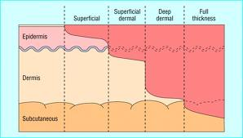
Burn Classification
1st Degree – Superficial
2nd Degree – Superficial Partial Thickness or Deep Partial Thickness
3rd Degree – Full thickness
4th Degree – To the bone

Slide 8
Important to remember!!
Skin holds the heat for 24-48 hours for most burns!
Grease burns will continue to burn for up to 72 hours!

Slide 9
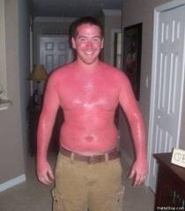
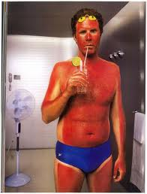
Superficial Burn
Destruction of the epidermis
Caused by sunlight of brief exposure to hot liquid
Red, hypersensitive, no blisters
Injured layer peel away and heal 5-7 days

Slide 10
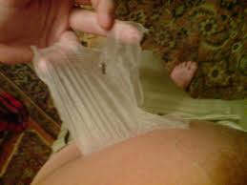
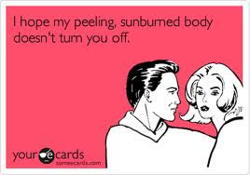
Treatment
May peel off after burning stops. Heals without scar
Cool compresses

Slide 11
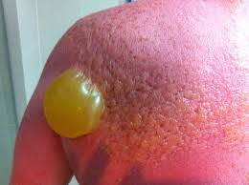
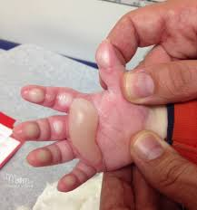
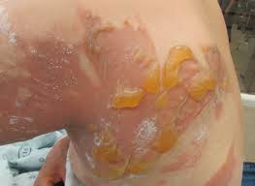
Partial thickness (Second degree)
Destruction of the epidermis and upper dermis
Blistered, very moist, red or pink
Heals 7-14 days
Extremely painful

Slide 12
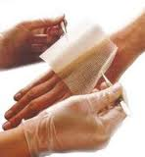
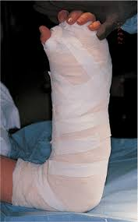
TREATMENT
If blisters are intact – leave them alone!
Cool compresses (room temp)
Analgesia
Topical anti-microbial agent with dressing

Slide 13
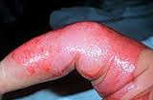
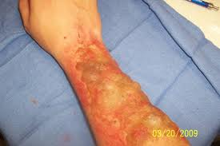
DEEP PARTIAL THICKNESS
Destruction of epidermis through to lower dermis
Caused from grease or longer contact with hot objects
Mottled pink to white
Dryer
Less sensitive to pin prick
Hair follicles and sweat glands intact
May not blanch to pressure

Slide 14
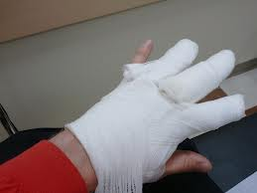
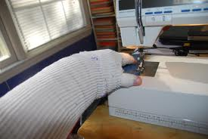
TREATMENT
Blisters make good dressings!
Debride only as blisters burst
Antimicrobial agent with bulky dressing (Bacitracin & Adaptic)
Heals spontaneously
Deep partial thickness may require grafting

Slide 15
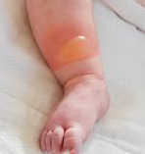
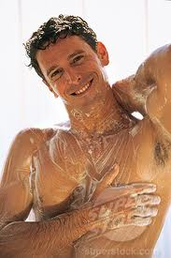
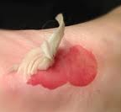
Debriding Burns
Leave intact blisters alone
Debride loose burned tissue
Clean process
Wash to remove debris & cream
If pt. able, allow pt. to debride

Slide 16
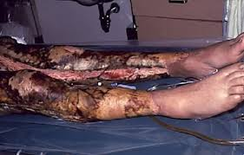
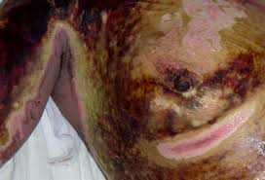
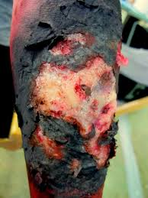
Full thickness (third degree)

Slide 17
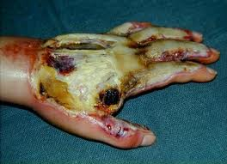
Full thickness
Destroys the epidermis and dermis
Dry
Leathery and firm to touch
Pale yellow white, brown or charred
No blanching to pressure
NO PAIN
Incapable of self -regeneration

Slide 18
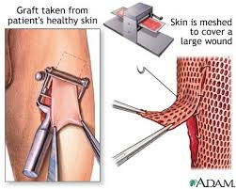
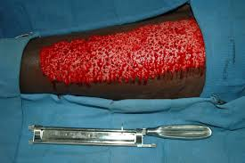
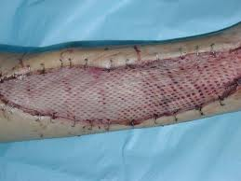
Full thickness burn Treatment
Excision of the eschar is necessary and requires skin grafting.
Must wait for the burning process to stop. Bacitracin & Adaptic or Flamazine dressings will be used until it is safe to operate.

Slide 19
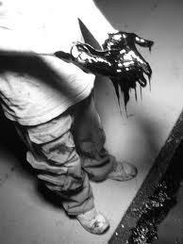
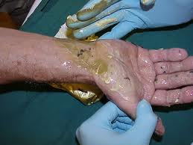
Tar burn
Removal of tar is important
Bacitracin ointment or mineral oil based substances can help soften tar to remove it

Slide 20
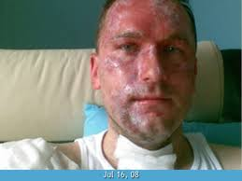
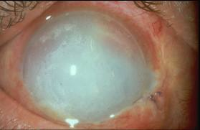
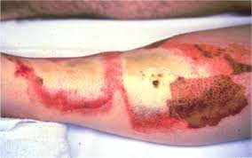
Chemical burns
ACID vs. ALKALI
Flush it out!!!

Slide 21
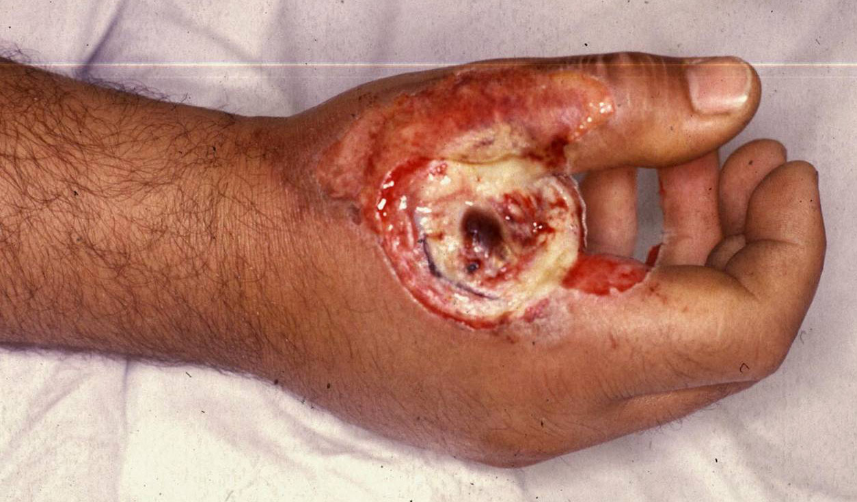
Electrical burns
Typical "entrance" site for high voltage injury. Note: the concave appearance of the hand burn reflecting tissue desiccation from passage of current Carpal tunnel syndrome is very common with a hand entrance.

Slide 22
Electrical burns
Burn severity will depend on:
Type of current
Location of electrical source
Duration of contact
Loss of consciousness

Slide 23
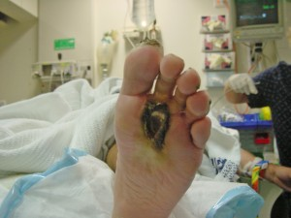
Electrical burns
EXIT WOUND
Remember that the current is exiting so the tissue damage is far more extensive than outer appearance. High voltage injury is a major burn!

Slide 24
Mechanism of Injury
So important!
Confined space?
What kind of liquid?
Causative agent?
Concurrent Injuries?

Slide 25
Assessment of the burn patient
AIRWAY

Slide 26
Airway
The most immediate threat from inhalation injury is upper airway obstruction from edema
Early airway intervention with a definitive airway may be necessary
Patent?
Hoarse voice?
Carbonaceous sputum?
Mouth and tongue edema?
Missing teeth?
Blood or mucous in airway?
Need for surgical crich?

Slide 27
Assessment of the burn patient
BREATHING

Slide 28
bREATHING
ALL BURN PATIENTS GET 100% O2 BY MASK!
CO and cyanide are 2 components of smoke
CO binds to Hgb more readily
Decreased O2 delivery to tissue
S&S: headache, obtundentation, nausea
Check: carboxyhemoglobin >15% is toxic

Slide 29
Assessment of the burn patient
CIRCULATION

Slide 30
CIRCULATION
Major burns should be considered for fluid resuscitation!
Parkland Formula
2-4mg/kg/TBSA

Slide 31
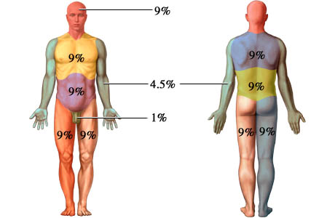
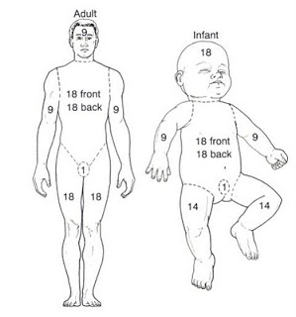
Rule of Nines

Slide 32
Scenario
56 year old male presents with approximately 50% body surface area burn from a car fire.
All lower body burns, no facial burns.
MD orders fluid resus as per Parkland formula using 4mg /kg.
Pt. estimates his weight at 70 kg

Slide 33
4 x 50 x 70
14,000 mls to be infused over 24 hours.
7000 in the first 8 hours and 7000 in the next 16 hours.
875 ml/hr x 8 hr and 438 ml/hr

